Slide 1
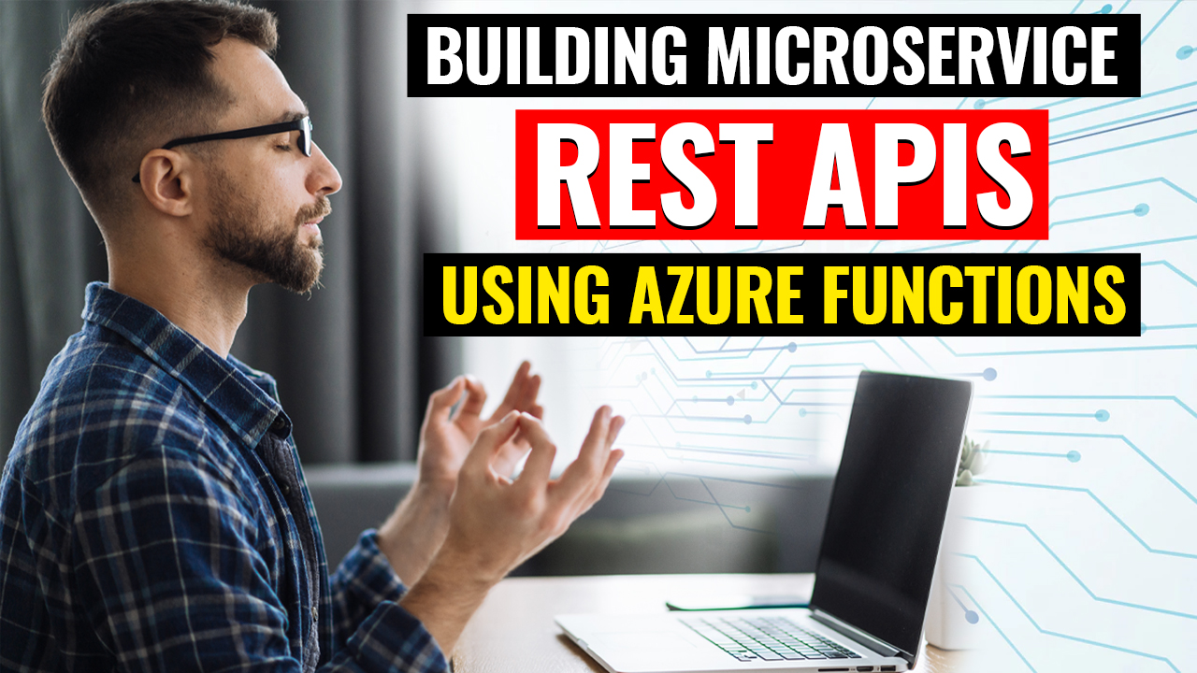

Slide 2






Who is Chad Green
chadgreen@chadgreen.com
TaleLearnCode
ChadGreen.com
ChadGreen & TaleLearnCode
ChadwickEGreen

Slide 3
What are microservices?
Building Microservice REST APIs Using Azure Functions

Slide 4
What are microservices?
Monolithic Architecture
Microservices Architecture
User Interface
User Interface
Business Logic
Microservice
Microservice
Microservice
Microservice
Application Database
Microservice
Database
Microservice
Database
Microservice
Database
Microservice
Database
Notes:
Imagine taking an application, chopping it up into pieces, and running it as a collection of smaller parts instead of one monolithic whole. That is basically what a microservices architecture is.
Monolithic Architecture — 3-Tier/N-Tier Architecture
One part of the application breaks, the whole application might fail
Microservices Architecture
From the user’s perspective, an application built with microservices has a single interface and should work just the same as an application designed as one stack. However, behind the scenes each microservice potentially has its own database and runs separately from the rest of the application. In addition, microservices within the same application can be written in different languages and use different libraries.

Slide 5
What are microservices?
Monolithic Architecture
Microservices Architecture
User Interface
User Interface
Business Logic
Microservice
Microservice
Microservice
Microservice
Application Database
Microservice
Database
Microservice
Database
Microservice
Database
Microservice
Database
Application
Database
Notes:
Anit-pattern that might make sense: one database

Slide 6
Advantages of Microservices
Quick
Notes:
Quick
Microservices increase agility putting new feature sin production and adding business value to solutions, as the deployment of small and independent modules requires much less time and several teams can be working on different services at the same time, reducing development time and simplifying deployment.

Slide 7
Advantages of Microservices
Quick

Slide 8
Advantages of Microservices
Quick
Resilience
Notes:
Resilience
Because the application is divided up, one part of the application breaking or crashing does not (should not) necessarily affect the rest of the application.
Each of the services can be managed independently, isolated potential problem areas to individual services, and replacing or retiring services when deprecated or unused without affecting the overall structure and functionality.

Slide 9
Advantages of Microservices
Quick
Scalability
Resilience
Resilience

Slide 10
Advantages of Microservices
Quick
Resilience
Scalability
Notes:
Scalability
Instead of scaling the entire application, only the microservices that receive a great deal of usage can be scaled.
The independent microservices modules and their related services can be individually and automatically scaled based on their respective demands without impacting the application’s overall performance. The ability to independently scale removes the need to scale the entire app up or down, potentially saving costs and reducing downtime.

Slide 11
Advantages of Microservices
Quick
Resilience
Scalability
Scalability
Maintainability

Slide 12
Advantages of Microservices
Quick
Resilience
Scalability
Maintainability
Notes:
Maintainability
Features can be rolled out or updated one at a time, instead of updating the entire stack.

Slide 13
Advantages of Microservices
Quick
Resilience
Scalability
Flexibility
Maintainability
Maintainability

Slide 14
Advantages of Microservices
Quick
Resilience
Scalability
Flexibility
Maintainability
Notes:
Flexibility
Microservices can be written in different languages and each have their own libraries.
Microservice solutions let development teams use the best deployment approach, language, platform and programming model for each service, providing flexibility in choosing technologies and tools.

Slide 15
Advantages of Microservices
Scalability
Resilience
Scalability
Quick
Resilience
Quick
Flexibility
Flexibility
Maintainability
Maintainability
Notes:
Quick
Microservices increase agility putting new feature sin production and adding business value to solutions, as the deployment of small and independent modules requires much less time and several teams can be working on different services at the same time, reducing development time and simplifying deployment.
Resilience
Because the application is divided up, one part of the application breaking or crashing does not (should not) necessarily affect the rest of the application.
Each of the services can be managed independently, isolated potential problem areas to individual services, and replacing or retiring services when deprecated or unused without affecting the overall structure and functionality.
Scalability
Instead of scaling the entire application, only the microservices that receive a great deal of usage can be scaled.
The independent microservices modules and their related services can be individually and automatically scaled based on their respective demands without impacting the application’s overall performance. The ability to independently scale removes the need to scale the entire app up or down, potentially saving costs and reducing downtime.
Maintainability
Features can be rolled out or updated one at a time, instead of updating the entire stack.
Flexibility
Microservices can be written in different languages and each have their own libraries.
Microservice solutions let development teams use the best deployment approach, language, platform and programming model for each service, providing flexibility in choosing technologies and tools.

Slide 16
Advantages of Microservices
Quick
Resilience
Scalability
Maintainability
Flexibility
Notes:
Quick
Microservices increase agility putting new feature sin production and adding business value to solutions, as the deployment of small and independent modules requires much less time and several teams can be working on different services at the same time, reducing development time and simplifying deployment.
Resilience
Because the application is divided up, one part of the application breaking or crashing does not (should not) necessarily affect the rest of the application.
Each of the services can be managed independently, isolated potential problem areas to individual services, and replacing or retiring services when deprecated or unused without affecting the overall structure and functionality.
Scalability
Instead of scaling the entire application, only the microservices that receive a great deal of usage can be scaled.
The independent microservices modules and their related services can be individually and automatically scaled based on their respective demands without impacting the application’s overall performance. The ability to independently scale removes the need to scale the entire app up or down, potentially saving costs and reducing downtime.
Maintainability
Features can be rolled out or updated one at a time, instead of updating the entire stack.
Flexibility
Microservices can be written in different languages and each have their own libraries.
Microservice solutions let development teams use the best deployment approach, language, platform and programming model for each service, providing flexibility in choosing technologies and tools.

Slide 17
REST
Building Microservice REST APIs Using Azure Functions

Slide 18
Introduction to REST
RE
S
T
REpresentational
State
Transfer
Notes:
REpresentational State Transfer (REST) is an architectural style that defines a set of constraints to be used for creating web services.

Slide 19

Introduction to REST
RE
S
T
REpresentational
State
Transfer
Notes:
The term was introduced and defined in 2000 by Roy Fielding in his doctoral dissertation.
The term is intended to evoke an image of how a well-designed Web application behaves: it is a network of Web resources (a virtual state machine) where the user advanced through the application by selecting links, resulting in the next resource’s representation (the next application state) being transferred to the client and rendered for the user.

Slide 20
Introduction to REST
RE
S
T
REpresentational
State
Transfer
Notes:
The term was introduced and defined in 2000 by Roy Fielding in his doctoral dissertation.
The term is intended to evoke an image of how a well-designed Web application behaves: it is a network of Web resources (a virtual state machine) where the user advances through the application by selecting links, resulting in the next resource’s representation (the next application state) being transferred to the client and rendered for the user.

Slide 21
Introduction to REST
RE
S
T
Client
Server
REpresentational
State
Transfer
Notes:
The term was introduced and defined in 2000 by Roy Fielding in his doctoral dissertation.
The term is intended to evoke an image of how a well-designed Web application behaves: it is a network of Web resources (a virtual state machine) where the user advanced through the application by selecting links, resulting in the next resource’s representation (the next application state) being transferred to the client and rendered for the user.

Slide 22
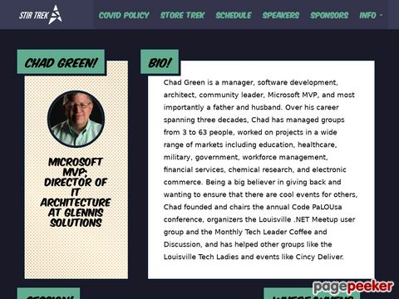
Introduction to REST
Client
Send Request
Server
stirtrek.com/speakers/2022/Chad-Green
Send Response
JSON, XML, HTML, SOAP, Image, etc.
Notes:
Next Screen: Some API principles, such as SOAP or XML-RPC, impose a strict framework on developers. But REST APIs can be developed using virtually any programming language and support a variety of data formats.

Slide 23
REST Architectural Constraints
Client-Server Architecture
Notes:
The only requirement is that they align to the following six architectural constraints
Client-Server Architecture / Decoupling
In REST API design, client and server applications must be completely independent of each other. The only information the client application should know is the URI of the requested resource; it cannot interact with the server application in any other way. Similarly, a sever application should not modify the client application other than passing it the requested data via HTTP.
Separation simplifies the server component, improving scalability; but more importantly, it allows components to evolve independently.

Slide 24
REST Architectural Constraints
Client-Server Architecture
Statelessness
Cacheability
Client-Server Architecture
Layered System
Code on Demand
(optional)
Uniform Interface
Notes:
Statlessness
REST APIs are stateless, meaning that each request needs to include all the information necessary for processing it. In other words, REST APIs do not require any server-side sessions. Server applications are not allowed to store any data related to a client request.
This property of statelessness, make RESTful APIs ideal in high volume applications and increases performance by removing sever load caused by the retention of session information.

Slide 25
REST Architectural Constraints
Statelessness
Cacheability
Client-Server Architecture
Statelessness
Layered System
Code on Demand
(optional)
Uniform Interface
Notes:
Cacheability
When possible, resources should be cacheable on the client or server side. Server responses also need to contain information about whether caching allowed for the delivered resource. The goal is to improve performance on the client side, while increasing scalability on the sever side.
Well-managed caching partially or completely eliminates some client–server interactions, further improving scalability and performance

Slide 26
REST Architectural Constraints
Cacheability
Client-Server Architecture
Statelessness
Cacheability
Layered System
Code on Demand
(optional)
Uniform Interface
Notes:
Layered System
A client cannot ordinarily tell whether it is connected directly to the send server or to an intermediary along the way. If a proxy or load balancer is placed between the client and server, it will not affect their communications, and there will not be a need to update the client or server code. Intermediary servers can improve system scalability by enabling load balancing and by providing shared caches. Also, security can be added as a layer on top of the web services, separating business logic from security logic. Finally, intermediary servers can call multiple other severs to generate a response to the client.
As a rule of thumb, do not assume that the client and sever applications connect directly to each other.

Slide 27
REST Architectural Constraints
Client-Server Architecture
Statelessness
Cacheability
Layered System
Code on Demand
(optional)
Uniform Interface
Layered System
Notes:
Code on demand (optional)
REST APIs usually send static resources, but in certain cases, responses can also contain executable code (such as Java applets). This allows the sever to temporarily extend or customize the functionality of a client.

Slide 28
REST Architectural Constraints
Client-Server Architecture
Statelessness
Cacheability
Code on Demand
(optional)
Uniform Interface
Layered System
Code on Demand
(optional)
Layered System
Notes:
Uniform Interface
The uniform interface constraint is fundamental to the design of any RESTful system. Basically, all API requests for the same resource should look the same no mater where the request comes from. There are four constraints for this uniform interface:
Resource identification in requests – Individual resources are identified in resources, for example using uniform resource identifiers (URIs). The resources themselves are conceptually separate from the representations that are returned for the client.
Resource manipulation through representations – When a client holds a representation of a resource, including any metadata attached, it has enough information to modify or delete the resource’s state.
Self-descriptive messages – Each message includes enough information to describe how to process the message.
Hypermedia as the engine of application state (HATEOAS) – Having accessed an initial URI for the REST application, a REST client should then be able to use server-provided links dynamically to discover all the available resources it needs. As access proceeds, the sever responds with text that includes hyperlinks to other resources that are currently available. There is no need for the client to be hard-coded with information regarding the structure or dynamics of the application.

Slide 29
REST Verbs
POST
Create
Response Code (HTTP Status Code)
Success – 201 (Created)
Failure – 400 (Bad Request)
Notes:
The POST verb is most-often utilized to create new resources.
POST is neither safe nor idempotent.
The HTTP 201 Created success status response code indicates that the request has succeeded and has led to the creation of a resource. The new resource is effectively created before this response is sent back and the new resource is returned in the body of the message, its location being either the URL of the request, or the content of the Location header.
The HTTP 400 Bad Request response status code indicates that the server cannot or will not process the request due to something that is perceived to be a client error (for example, malformed request syntaxt, invalid request message framing, or deceptive request routing). The client should not repeat this request without modification.

Slide 30
REST Verbs
POST
Create
GET
Read
POST
Create
Response Code (HTTP Status Code)
Success – 200 (OK)
Failure – 404 (Not Found)
Failure – 400 (Bad Request)
Notes:
The GET method is used to read (or retrieve) a representation of a resource.

Slide 31
REST Verbs
POST
Create
GET
Read
GET
Read
PUT
Update
Response Code (HTTP Status Code)
Success – 204 (No Content)
Success – 201 (Created)
Failure – 404 (Not Found)
Failure – 400 (Bad Request)
Notes:
The PUT verb is used for updating the resource.
PUT can also be used to create a resource in the case where the resource identifier is specified by the client instead of the server. This could also be considered an Upsert

Slide 32
REST Verbs
POST
Create
GET
Read
PUT
Update
PUT
Update
PATCH
~Update
Response Code (HTTP Status Code)
Success – 204 (No Content)
Failure – 404 (Not Found)
Failure – 400 (Bad Request)

Slide 33
REST Verbs
POST
Create
GET
Read
PUT
Update
PATCH
~Update
DELETE
Delete
PATCH
~Update
Response Code (HTTP Status Code)
Success – 200 (OK)
Failure – 404 (Not Found)
Failure – 400 (Bad Request)

Slide 34
What is Serverless?
Building Microservice REST APIs using Azure Functions

Slide 35






The evolution of application platforms
On-Premises
What happens in case of
server hardware failure?
How can I increase
server utilization?
What media should I
use to keep backups?
What size of servers
should I buy?
How do I deploy new
code to my servers?
Who monitors
my apps?
How often should I
backup my server?
How can I scale my app?
Which packages should
be on my server?
Are my servers in
a secure location?
Do I need a secondary
Network connection?
How do I keep the operating
system up to date?
Who has physical
access my servers?
Who monitors
my servers?
What storage do
I need to use?
How many
servers
do I need?
What happens in case of
server hardware failure?
Do I need a UPS?
How can I dynamically
configure my app?
It takes how long to
provision a new server?
How often should I
patch my severs?
Notes:
Get Hardware
Get and install your operating system
Get and install the application framework
(No Click) Deploy code to the server
Host all of this somewhere in your datacenter and make available to the Internet
(No Click) Bunch of questions
Backup for your apps
Physical Security
Scaling Up
Monitoring (hardware and application)
And so on
(No Click) Really important questions – but not key to core competency

Slide 36
The evolution of application platforms
On-Premises
What happens in case of
server hardware failure?
How can I increase
server utilization?
What media should I
use to keep backups?
What size of servers
should I buy?
How do I deploy new
code to my servers?
Who monitors
my apps?
How often should I
backup my server?
How can I scale my app?
Which packages should
be on my server?
Are my servers in
a secure location?
Do I need a secondary
Network connection?
How do I keep the operating
system up to date?
Who has physical
access my servers?
Who monitors
my servers?
What storage do
I need to use?
How many
servers
do I need?
What happens in case of
server hardware failure?
Do I need a UPS?
How can I dynamically
configure my app?
It takes how long to
provision a new server?
How often should I
patch my severs?
Notes:
Get Hardware
Get and install your operating system
Get and install the application framework
(No Click) Deploy code to the server
Host all of this somewhere in your datacenter and make available to the Internet
(No Click) Bunch of questions
Backup for your apps
Physical Security
Scaling Up
Monitoring (hardware and application)
And so on
(No Click) Really important questions – but not key to core competency

Slide 37
The evolution of application platforms
IaaS
What happens in case of
server hardware failure?
What is the right size of servers for my business needs?
How can I increase
server utilization?
How can I increase server utilization?
What media should I
use to keep backups?
What size of servers
should I buy?
How do I deploy new
code to my servers?
How many servers do I need?
How can I scale my application?
Who monitors
my apps?
How often should I
backup my server?
How can I scale my app?
Which packages should
be on my server?
Are my servers in
a secure location?
Do I need a secondary
Network connection?
How do I keep the operating
system up to date?
Who has physical
access my servers?
How do I deploy new code to my server?
How often should I patch my servers?
Who monitors
my servers?
What storage do
I need to use?
How many
servers
do I need?
How do I keep the operating system up to date?
How often should I backup my server?
Who monitors my application?
Which packages should be on my server?
What happens in case of
server hardware failure?
Do I need a UPS?
How can I dynamically
configure my app?
It takes how long to
provision a new server?
How often should I
patch my severs?

Slide 38

The evolution of application platforms
PaaS
What is the right size of servers for my business needs?
How can I increase server utilization?
How many servers do I need?
How can I scale my application?
How do I deploy new code to my server?
How often should I patch my servers?
How do I keep the operating system up to date?
How often should I backup my server?
Which packages should be on my server?
Who monitors my application?
Notes:
A lot of decisions are easily configurable
(Click) But still have to think about how to scale

Slide 39
The evolution of application platforms
Serverless

What is the right size of servers for my business needs?


How can I increase server utilization?

How many servers do I need?




How can I scale my application?





























Notes:
Only Problem: How to build you application to best solve business problem?

Slide 40
The evolution of application platforms
Serverless






































Slide 41
Not there isn’t servers
Just, you can think about the servers less
Server Configuration
Server Scaling
Notes:
You focus less on servers and more on the functionality and features of your solution.
Abstraction
This is because serverless abstracts away servers so you do not need to worry about server configuration or scaling

Slide 42
Serverless Benefits
No Server Management

Slide 43
Serverless Benefits
Simplified Scalability
No Server Management
No Server Management

Slide 44
Serverless Benefits
No Server Management
Simplified Scalability

Slide 45
Serverless Benefits
No Server Management
Simplified Scalability
Simplified Scalability
Lower Costs

Slide 46
Serverless Benefits
No Server Management
Simplified Scalability
Lower Costs

Slide 47
Serverless Benefits
No Server Management
Simplified Scalability
Lower Costs
Lower Costs
Quicker Turnaround

Slide 48
Serverless Benefits
No Server Management
Simplified Scalability
Lower Costs
Quicker Turnaround

Slide 49
Serverless Benefits
No Server Management
Simplified Scalability
Lower Costs
Simplified Code
Quicker Turnaround
Quicker Turnaround

Slide 50
Serverless Benefits
No Server Management
Simplified Scalability
Lower Costs
Simplified Code
Quicker TUrnaround

Slide 51
Serverless Benefits
Scalability
Resilience
Lower Costs
Quick
Simplified Scalability
No Server Management
Simplified Code
Simplified Code
Maintainability
Quicker Turnaround

Slide 52
Serverless Benefits
No Server Management
Simplified Scalability
Lower Costs
Quicker Turnaround
Simplified Code

Slide 53
Disadvantages of Serverless
Testing Challenges

Slide 54
Disadvantages of Serverless
Security Concerns
Testing Challenges
Testing Challenges

Slide 55
Disadvantages of Serverless
Testing Challenges
Security Concerns
Notes:
Vendors run the entire backend
Providers often running code from several customers on single server at any given time (multitenancy)

Slide 56
Disadvantages of Severless
Testing Challenges
Short-Running Processes
Security Concerns
Security Concerns

Slide 57
Disadvantages of Serverless
Testing Challenges
Security Concerns
Short –Running Processes

Slide 58
Disadvantages of Serverless
No Server Management
Simplified Scalability
Short-Running Processes
Cold Starts
Short-Running Processes

Slide 59
Disadvantages of Serverless
Testing Challenges
Security Concerns
Short-Running Processes
Cold Starts

Slide 60
Disadvantages of Serverless
Testing Challenges
Security Concerns
Short-Running Processes
Cold Starts
Cold Starts
Vendor
Lock-In

Slide 61
Disadvantages of Serverless
Testing Challenges
Security Concerns
Short-Running Processes
Vendor
Lock-In
Cold Starts

Slide 62
Disadvantages of Serverless
Scalability
Resilience
Short-Running Processes
Quick
Security Concerns
Testing Challenges
Vendor
Lock-In
Vendor
Lock-In
Maintainability
Cold Starts

Slide 63
Disadvantages of Serverless
Testing Challenges
Security Concerns
Short-Running Processes
Cold Starts
Vendor
Lock-In

Slide 64
Serverless vs Containers
Building Microservice REST APIs Using Azure Functions

Slide 65
Serverless vs Containers
Physical Machines
Notes:
As we talked about; serverless does run on servers, but it is up to the vendor to provision server space as it is needed by the application; no specific machines are assigned for a given function or application.
On the other hand, each container lives on one machine at a time and uses the operating system of that machine, though they can be moved easily to a different machine if desired.

Slide 66
Serverless vs Containers
Scalability
Notes:
In a container-based architecture, the number of containers deployed is determined beforehand. In contrast, in a serverless architecture, the backend inherently and automatically scales to meet demand.

Slide 67
Serverless vs Containers
Maintenance
Notes:
Containers are hosted in the cloud, but cloud providers do not necessarily update or maintain them.
From a developer’s prospective, a serverless architecture has no backend to manage.

Slide 68
Serverless vs Containers
Time of Deployment
Notes:
Containers take longer to set up initially than serverless functions because it is necessary to configure system settings, libraries, and so on. Once configured, containers take only a few seconds to deploy.
Because serverless functions are smaller than containers and do not come bundled with system dependencies, they only take milliseconds to deploy. Serverless applications can be live as soon as the code is uploaded.

Slide 69
Serverless vs Containers
Testing
Notes:
It is difficult to test serverless web applications because the backend environment is hard to replicate on a local environment. In contrast, containers run the same no matter where they are deployed, making it relatively simple to test a container-based application before deploying it to production.

Slide 70
Serverless vs Container
 | Serverless | Containers
Physical Machines | X
Scalability | X
Maintenance | X
Time of Deployment | X
Testing |  | X

Slide 71
Function-as-a-Service (FaaS)
Building Microservice REST APIs Using Azure Functions

Slide 72
Function-as-a-Service (FaaS)
Small Bits of Code
Responds to Triggers

Slide 73
Function-as-a-Service (FaaS)
Small Bits of Code
Responds to Triggers

Slide 74
Function-as-a-Service (FaaS)
Small Bits of Code
Responds to Triggers
Monolithic Application
Microservice
Function
Function
Microservice
Function
Function
Microservice
Function
Function

